Slide 1


Reference Enterprise Architecture
for Security orchestration

Slide 2

Register
CMDB
PKI
Hardware
Disaster
SASE
Security
Notifications
Risk
Updates
Digital
Tokens
translation
Recovery
Key vaults
Architecture
Management
Token
Signatures
Asset
Privacy
IoT
sec
discovery
Information Asset
Interoperability
Keys
SSI
Decoys
Enforcement
Forensics
Burden
Security
SDK
Continuity
of proof
Policy
Archiving
Firewalls
Testing
Business
Access
SecOps
Regulatory
AI
Management
KYC
Identity &
prevention
Vendor
Compliance
UX
Simulation
Data loss
Delegation
Non-repudiation
Anti-fraud
Model
Profile Management
Maturity
check
ITSM
Awareness
AML
Frameworks
Modelling
Zero trust
PSM
marking
CASB
Bench
Security
Threat
RPA
Liveliness
PAM
Standardisation
XDR
Auditing
CAE
Endpoint Security
SoC
Certificates
Controls
eID
Notes:
This image is characterising how cybersecurity looks in nowadays corporate environments
Colorful: addressing multiple aspects of security
Complex: Even if usually all well-intended, application builders have this reflex to build their own security ecosystem, making it difficult to align on security principles across the entire organisation, and the complexity created here unfortunately leads to less security.
Obscure: Security processes are often designed off-line and do not represent or visualise the actual state in security orchestration - out of sight is out of mind
Change-prone: modernising one security aspect likely triggers a domino-effect of changes (ex: migrating apps from one IdP to another are often multi-year exercises, let alone multi-decade, and often require to change hard-coded logic or modernise the runtime environment to adopt modern authentication methods)
Non-redundant: if one security validator fails, the entire security process fails. In other words, danger of running out of business is always luring behind the corner if you can’t contain or get some flexibility to review and increment the maturity of your security processes.
This is why in many corporate environments, there is growing consensus on the adoption of an additional architectural layer to coordinate and sequence and all these specialised security functions. In the minds of enterprise architects and decision makers, this layer is paramount to future-proof all flavors, approaches and security principles into a system that offers enough visibility to see any potential security gap, to see any potential room for improvement and offers the flexibility to simulate, change and test user journeys in a top-down approach. In contrast, applications are nowadays orchestrating all user journeys and security functions in a non-standard hard-coded fashion, which is highly vulnerable, obscure, change-aversive and therefore static by default.
We can therefore invoke a new class of applications that cover this new need: security orchestrators.
As you can see in this large puzzle of security functions, architects do not perceive a security orchestrator as a security tool by itself.

Slide 3

Layered security architecture
Network
security
Endpoint
security
App
security
Perimeter
security
Data
security
Human layer
Mission-critical
security
Notes:
As I already mentioned, architects see this as a layer above all this. Moreover, we can argue about whom presumably should be the owner of the tool. Architects see security orchestrators as tools purposed in the first place for non-security people to enchain security functions into their business processes, mostly user journeys, without all the security knowledge required to build these functions. In practice, product owners are not highly trained in cybersecurity, but still, they are factually responsible for the requirement gathering, scoping and driving projects which entail the development of security functions. The most useful benefit, I think, for creating security orchestration as an additional layer, allows cybersecurity people to enforce product owners and application builders to use security functions approved or manufactured by the cybersecurity department, which is enforcing modularity, high levels of standardisation and quality control, and last but not least, clear security ownership and accountability.
When looking at all the typical 7 security layers, the security orchestrator is covering a great deal across all the aspects in corporate security.
I will not go in high detail across these aspects, I only want to say that requirement gathering and maturity evaluation of a security orchestrator is the result of a deep analysis of the security aspects, layer by layer.
What is a security orchestrator ?
= separate architectural layer
Any businesses highly relying on human capital to realise their objectives, minds about maximising efficiency of their workforce. Digital transformation initiatives mainly address process efficiency by automating business processes, and therefore use orchestrators to sequence all the automations into logical customer journeys.
In nowadays IT ecosystems, we observe
- highly specialised IT tooling to address business-focused challenges (but with less or no process management functions)
- and generic IT solutions with no or shallow business-focused specialisation to flexibly run or ‘orchestrate’ the sequence of highly specialised functions. An orchestrator is basically a finite-state machine, that only proceeds to the next step if specific gate conditions are met.
So, once we have both highly specialised tooling and transversal tooling to orchestrate any digitally transformed processes, we have it all, right ?
Unfortunately, generic orchestrators are usually not fit for purpose to drive mission-critical and business-critical security functions. Imagine an access control process based on email automation. It is clear that email automation is not fit for purpose to orchestrate a security function that could literally leak the ‘keys to the kingdom’, not to mention that this sort of generic solution would demand considerable effort, as it is not tailored to gracefully integrate with security-focused components.
This is where we need a security orchestrator, pre-dispositioned with basic security functions, integrating with specialised security components, and by itself built with all security due diligence in mind.
In a financial institution for example, a security orchestrator is commonly used in customer facing mobile banking apps. Many security functions play a role in reducing risks associated with sensitive information and sensitive actions, running on highly exposed personal devices. A security orchestrator here typically plays a role in securing:
Customer registration
Customer consent
Customer Identity proofing & data quality assurance
Customer authorisation
Device identity proofing & data quality assurance
Device integrity
Activity logging, monitoring and archiving
KYC assessment, fraud detection and mitigation
Safe user & device disenrollment, data retention and disposal

Slide 4
Secure behavior
privacy
Secure by design
human
layer
customer behavior
policies
workforce behavior
training
GDPR
Tech. manufacturers
Tech. consumers
SSI
perimeter
security
endpoint
security
Notes:
Human defense layer
Govern all security processes in one place -> capture all behavioral data in one place
Link extra information along the process referring to best practice to identify phishing behavior
Split responsibility between security component development and enablement vs user journey process design (Cybersecurity vs Digital transformation)
Often, security is built in digital transformation teams, usually driven by “time to market” instead of security.
Security component development remains CISO responsibility
—-----
I’m not going to explain in-depth why we need Enterprise Architecture, this deck is purposed to sharpen our insights on corporate access from a business perspective, and, I’d like to add a little twist by drawing your attention on issues we often see in absence of enterprise architectural authority.
that can arise from loose architectural control or loose interaction between business and IT on Identity & Access Management topics. Corporate Identity & Access Management, let alone any course corrections or adjustments in this domain represent serious and hard to justify investments.
Most IAM solutions are subscription models based on user population or authentication attempts
. Therefore scaling up causes a linear cost increase, with barely any advantage of scale.
and also explain what happens in case Identity & Access Management is not
CISOs and heads of security usually encounter in Cybersecurity-centric business contexts.
This deck is about corporate Identity & Access Management. By corporate, we mean all actors or personas that play a role in enabling business opportunities. In other words, all actors in the business ecosystem, except customers.
Of course, there are security frameworks that both help to identify gaps and propose good practices to alleviate specific concerns. Still, these frameworks are too technical to function as working documents at the management level. But as a global IT company with vast cross-industry experience and my long personal experience in IT project management and Enterprise Security Architecture, I’m sure Cybersecurity leadership rather likes to hear the pragmatic approach.
So, this exercise will not explain solutions in great detail but only put them in context by connecting the dots.
Connecting the dots, being the main purpose of Enterprise Architecture, results in a stable framework that keeps all the solutions in check with the security controls and security due diligence offered by technology, people and processes.
So, let’s go through a first architectural foundation covering a great cross-section of the Cybersecurity subjects a CISOs and heads of Cybersecurity are managing.
As we navigate the evolving landscape of cybersecurity, it's imperative for [Company Name] to fortify its defenses and ensure a resilient information security framework. Of course, I’m aware that you have already figured out an architecture that is fit for purpose, and I’m sure it has gone through multiple iterations already.
cybersecurity concerns we have captured fr
Thes reference architecture So’ what’s The Challenge here ?
First of all, Cybersecurity and Information security is a moving target. Therefore, realistically, IT does not manage to implement all the security needs to the full across the entire application and data landscape. I
I am not a professional security auditor, but from my experience as IT project manager for more than 20 years, I know, even in the largest banks on European soil, this situation is prevalent.
Corporations usually end up with a mix of products, IT architectures, temporary adaptations that become permanent and so on…
In today's interconnected world, the traditional perimeter is fading, making IAM a linchpin in our security strategy. Siloed and ad-hoc IAM solutions can lead to inefficiencies, compliance gaps, and heightened security risks. It's time to elevate our IAM game.
The Solution:
I propose the implementation of a comprehensive IAM Reference Architecture tailored for [Company Name]. This framework will provide a standardized blueprint, ensuring consistency, scalability, and resilience across our identity and access management practices.
Key Benefits:
Efficiency and Consistency: Streamline IAM processes, reduce redundancy, and establish a consistent approach to user access across the organization.
Scalability: As we grow, our IAM framework will seamlessly scale, accommodating new users, applications, and technologies without compromising security.
Risk Mitigation: Strengthen security postures by enforcing least privilege principles, enhancing authentication methods, and proactively addressing potential vulnerabilities.
Regulatory Compliance: Align our IAM practices with industry regulations and standards, ensuring that we not only meet but exceed compliance requirements.
Cost-effectiveness: By optimizing IAM processes and leveraging a standardized architecture, we can realize cost savings over time.
Next Steps:
I propose a meeting to discuss this initiative further. We can delve into the specifics, address any questions or concerns, and outline a roadmap for the seamless integration of our IAM Reference Architecture.
Our commitment to securing our digital assets is unwavering, and I believe that implementing a robust IAM Reference Architecture is a strategic move toward a more secure and agile future.
Thank you for your time, and I look forward to the opportunity to discuss this initiative in greater detail.
Best regards,
ACL, RBAC, ABAC (PBAC= ABAC with dynamic rules, CBAC= ABAC from MSFT), ACL, RAdAC
https://cloudentity.com/news/acl-rbac-abac-pbac-radac-and-a-dash-of-cbac/
ACL: Your name is on the list
RAdAC: You have been to a country with a COVID outbreak
ABAC: You’re the right age
RBAC: You have the role of system administrator

Slide 5
Device binding
app security
Logical Access Mgt (LAM) orchestration
Privileged Access Mgt
(PAM)
Provisioning
Identity scoping
AuthN
AuthZ
Access
Principles & Policies
data security
B2E
B2B
SAML
SSO
Coarse-grain
Emergency
SoD
PSM
Insider Threat Mgt
JML
JIT
M2M
B2C
OAuth
MFA
Fine-grain
Least privilege
Password Mgt
Vault
Citizen
B2B2C
OIDC
Digikey
ACL, ABAC, RBAC, RAdAC
mission-critical security
Notes:
I’m not going to explain in-depth why we need Enterprise Architecture, this deck is purposed to sharpen our insights on corporate access from a business perspective, and, I’d like to add a little twist by drawing your attention on issues we often see in absence of enterprise architectural authority.
that can arise from loose architectural control or loose interaction between business and IT on Identity & Access Management topics. Corporate Identity & Access Management, let alone any course corrections or adjustments in this domain represent serious and hard to justify investments.
Most IAM solutions are subscription models based on user population or authentication attempts
. Therefore scaling up causes a linear cost increase, with barely any advantage of scale.
and also explain what happens in case Identity & Access Management is not
CISOs and heads of security usually encounter in Cybersecurity-centric business contexts.
This deck is about corporate Identity & Access Management. By corporate, we mean all actors or personas that play a role in enabling business opportunities. In other words, all actors in the business ecosystem, except customers.
Of course, there are security frameworks that both help to identify gaps and propose good practices to alleviate specific concerns. Still, these frameworks are too technical to function as working documents at the management level. But as a global IT company with vast cross-industry experience and my long personal experience in IT project management and Enterprise Security Architecture, I’m sure Cybersecurity leadership rather likes to hear the pragmatic approach.
So, this exercise will not explain solutions in great detail but only put them in context by connecting the dots.
Connecting the dots, being the main purpose of Enterprise Architecture, results in a stable framework that keeps all the solutions in check with the security controls and security due diligence offered by technology, people and processes.
So, let’s go through a first architectural foundation covering a great cross-section of the Cybersecurity subjects a CISOs and heads of Cybersecurity are managing.
As we navigate the evolving landscape of cybersecurity, it's imperative for [Company Name] to fortify its defenses and ensure a resilient information security framework. Of course, I’m aware that you have already figured out an architecture that is fit for purpose, and I’m sure it has gone through multiple iterations already.
cybersecurity concerns we have captured fr
Thes reference architecture So’ what’s The Challenge here ?
First of all, Cybersecurity and Information security is a moving target. Therefore, realistically, IT does not manage to implement all the security needs to the full across the entire application and data landscape. I
I am not a professional security auditor, but from my experience as IT project manager for more than 20 years, I know, even in the largest banks on European soil, this situation is prevalent.
Corporations usually end up with a mix of products, IT architectures, temporary adaptations that become permanent and so on…
In today's interconnected world, the traditional perimeter is fading, making IAM a linchpin in our security strategy. Siloed and ad-hoc IAM solutions can lead to inefficiencies, compliance gaps, and heightened security risks. It's time to elevate our IAM game.
The Solution:
I propose the implementation of a comprehensive IAM Reference Architecture tailored for [Company Name]. This framework will provide a standardized blueprint, ensuring consistency, scalability, and resilience across our identity and access management practices.
Key Benefits:
Efficiency and Consistency: Streamline IAM processes, reduce redundancy, and establish a consistent approach to user access across the organization.
Scalability: As we grow, our IAM framework will seamlessly scale, accommodating new users, applications, and technologies without compromising security.
Risk Mitigation: Strengthen security postures by enforcing least privilege principles, enhancing authentication methods, and proactively addressing potential vulnerabilities.
Regulatory Compliance: Align our IAM practices with industry regulations and standards, ensuring that we not only meet but exceed compliance requirements.
Cost-effectiveness: By optimizing IAM processes and leveraging a standardized architecture, we can realize cost savings over time.
Next Steps:
I propose a meeting to discuss this initiative further. We can delve into the specifics, address any questions or concerns, and outline a roadmap for the seamless integration of our IAM Reference Architecture.
Our commitment to securing our digital assets is unwavering, and I believe that implementing a robust IAM Reference Architecture is a strategic move toward a more secure and agile future.
Thank you for your time, and I look forward to the opportunity to discuss this initiative in greater detail.
Best regards,
ACL, RBAC, ABAC (PBAC= ABAC with dynamic rules, CBAC= ABAC from MSFT), ACL, RAdAC
https://cloudentity.com/news/acl-rbac-abac-pbac-radac-and-a-dash-of-cbac/
ACL: Your name is on the list
RAdAC: You have been to a country with a COVID outbreak
ABAC: You’re the right age
RBAC: You have the role of system administrator

Slide 6
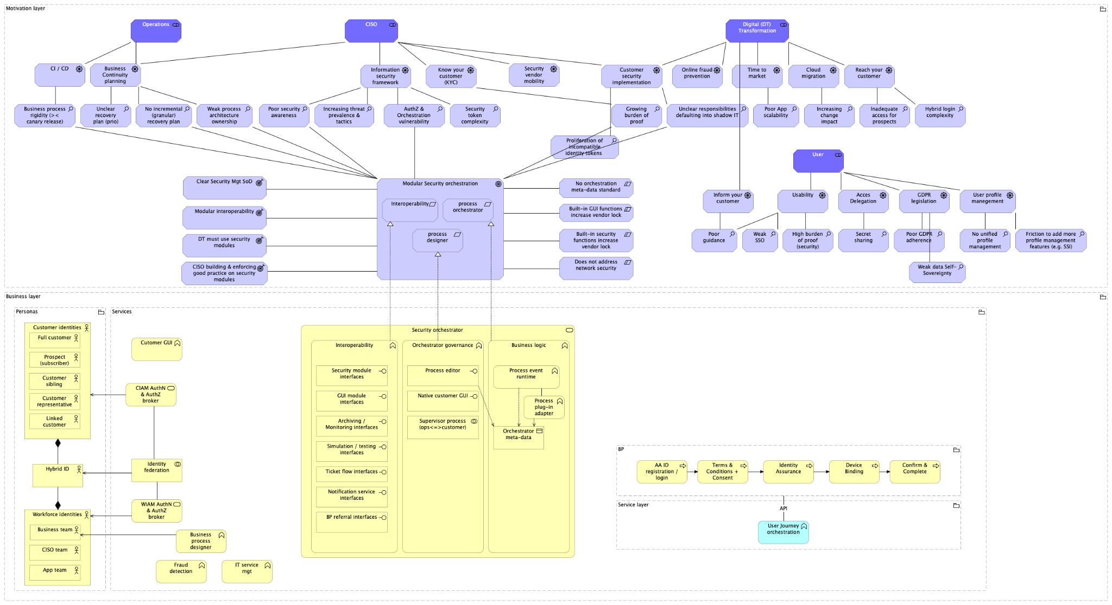

Slide 7
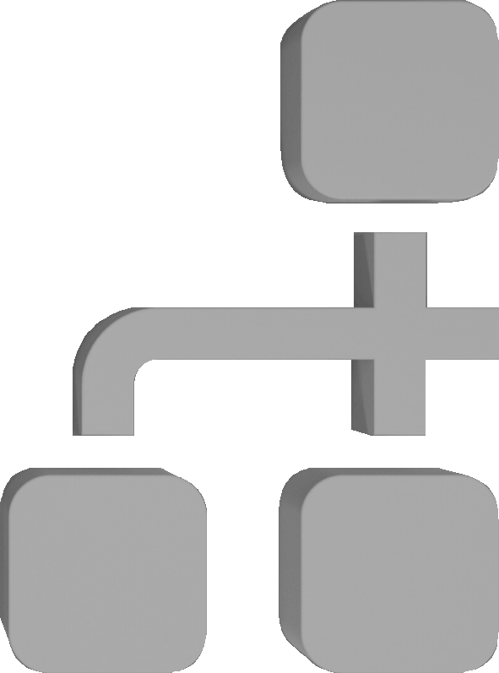


Processes
IT Service &
Operations
Processes
Project
Processes
Workforce
Business
Processes
B2B / Vendor
Business
Processes
Customer
Business
Processes
Security &
Compliance
Processes
ITSM
RPA
Program / Project Mgt
Change Mgt
Business Admin
HR
Training
Vendor management
Procurement
CRM
Self-service App
Notes:
Security orchestration as a design pattern
Enabling multiple actors to collaborate and contribute to a multi-channel user experience. product owners, channel owners, fraud(the pretend to be not security), other related security processes and business analysts to design their security processes (still independently) from modular components (channels use to implement the same functions multiple times, resulting in less maturity, higher obscurity and disarray) -> avoid multiple incompatible token sets
Transparacy: Offer visually intuitive process diagramming. Security architecture becomes one with implementation.
Enable KYC process simplification and transformation (SSI). (Why are current orchestrators too rigid => temp becomes permanent
Enable phased rollout of new user journeys
Enable better user journey testing.
Allow easier deconstruction of Idp vendor hegemony in security process orchestration (reduce vendor lock-in)
Allow quicker and more standardised app onboarding. Move AuthZ out of codebase to centralised agent. Less scattering of security functions, and move them to less vulnerable environments.
Offer better claritty and responsiveness during bcp. (Better mitigation returning from stable state to desired). Easy desig. Of break the glass processes
Collect process metadata on security coverage and security maturity levels (better goal settibg) (showing % of legacy security measures)
Lower downtime during security process upgrades and patching.
What is a security orchestrator ?
Any businesses highly relying on human capital to realise their objectives, minds about maximising efficiency of their workforce. Digital transformation initiatives mainly address process efficiency by automating business processes, and therefore use orchestrators to sequence all the automations into logical customer journeys.
In nowadays IT ecosystems, we observe
- highly specialised IT tooling to address business-focused challenges (but with less or no process management functions)
- and generic IT solutions with no or shallow business-focused specialisation to flexibly run or ‘orchestrate’ the sequence of highly specialised functions. An orchestrator is basically a finite-state machine, that only proceeds to the next step if specific gate conditions are met.
So, once we have both highly specialised tooling and transversal tooling to orchestrate any digitally transformed processes, we have it all, right ?
Unfortunately, generic orchestrators are usually not fit for purpose to drive mission-critical and business-critical security functions. Imagine an access control process based on email automation. It is clear that email automation is not fit for purpose to orchestrate a security function that could literally leak the ‘keys to the kingdom’, not to mention that this sort of generic solution would demand considerable effort, as it is not tailored to gracefully integrate with security-focused components.
This is where we need a security orchestrator, pre-dispositioned with basic security functions, integrating with specialised security components, and by itself built with all security due diligence in mind.
In a financial institution for example, a security orchestrator is commonly used in customer facing mobile banking apps. Many security functions play a role in reducing risks associated with sensitive information and sensitive actions, running on highly exposed personal devices. A security orchestrator here typically plays a role in securing:
Customer registration
Customer consent
Customer Identity proofing & data quality assurance
Customer authorisation
Device identity proofing & data quality assurance
Device integrity
Activity logging, monitoring and archiving
KYC assessment, fraud detection and mitigation
Safe user & device disenrollment, data retention and disposal

Slide 8











Corporate perimeters & personas/assets
Internal
Contractor
Affiliate
internal
Affiliate
contractor
B2B Admin
B2B Partner
Customer
Franchise Customer
Digital
Citizen
(prospect)
HPA
B2E
internal
B2E affiliates
B2B
delegates
B2B
non-affiliates
B2C
registered
B2B2C registered
B2C
unregistered
data recovery on personas
data recovery on information assets
SYS
external
Robotic
Business critical
(mainframe)
Mission critical
(applications)
B2B Systems
Notes:
Each Identity and Access Management system architecture must be tailored to
the organisational structure and the complexity of that structure - depending on the number of corporate personas
the security posture - to safeguard the nature of the business itself
the digital transformation - to remain ahead of competing business actors
are often dictated by a combination of regulatory requirements, organizational policies, industry standards, and the specific nature of the data and systems being protected.
Information security needs are often dictated by a combination of regulatory requirements, organizational policies, industry standards, and the specific nature of the data and systems being protected. Here are some key factors:
Regulations and Compliance: Many industries have specific regulations that dictate how certain types of information should be handled and secured. For example, healthcare has HIPAA, finance has PCI DSS, and there are various data protection laws globally.
Organizational Policies: Companies often establish their own internal policies and procedures to ensure the confidentiality, integrity, and availability of their information. These policies may be influenced by industry best practices.
Risk Management: Information security needs are also determined by an organization's risk management strategy. Understanding potential risks helps in implementing appropriate security measures to mitigate those risks.
Data Sensitivity: The sensitivity of the data being handled is a critical factor. Highly confidential or personally identifiable information requires more stringent security measures than less sensitive data.
Industry Standards: Following widely accepted security standards and frameworks, such as ISO 27001 or NIST, can provide a solid foundation for designing and implementing security measures.
Technology Landscape: The technologies in use also influence security needs. Cloud-based systems, mobile devices, and other technologies require specific security considerations.
Incident Response Requirements: The ability to respond to and recover from security incidents is a crucial aspect of information security planning. Security measures are often designed to facilitate effective incident response.
User Behavior and Education: Human factors play a significant role. Security needs are influenced by the awareness and behavior of end users. Training programs and awareness campaigns are essential components.
Considering these factors collectively helps organizations create a comprehensive and effective information security strategy. In your role in Enterprise Architecture, aligning security measures with the overall architecture and business objectives is crucial for a robust security posture.
Before we The first key approach to
HR limit: boundaries within which default corporate HR trust exists. B2B partners usually have an HR system but no trust by default.
IGA limit: boundaries within which users are entitled to perform user, role and permission management (including creation/deletion)
FIM limit: boundaries within which we can federate corporate identities into one identity per person
In the realm of Identity & Access Management (IAM), various personas play crucial roles in maintaining corporate identities and security. Here are a few key personas:
End Users: These are employees, contractors, or anyone else using the organization's systems and applications. Their access needs are typically defined by their job roles.
Administrators: IAM administrators manage user identities, access permissions, and overall security policies. They ensure that the right people have the right access.
Managers: Managers may have elevated privileges to oversee and manage the access rights of their team members. This is often essential for efficient workflow management.
Auditors: Auditors require access to IAM systems to assess and validate the security posture of the organization. They play a crucial role in ensuring compliance with regulatory standards.
Developers: In a corporate setting, developers may have specific access requirements to development environments, version control systems, and other tools critical to their work.
Vendors/Partners: External entities like vendors or partners may need temporary or limited access to specific resources within the corporate environment.
Automated Systems/Bots: Some IAM systems need to manage access for automated systems or bots that perform various tasks, such as data processing or system maintenance.
Each persona has unique access needs, and effective IAM ensures that access is granted based on job roles, responsibilities, and the principle of least privilege.

Slide 9
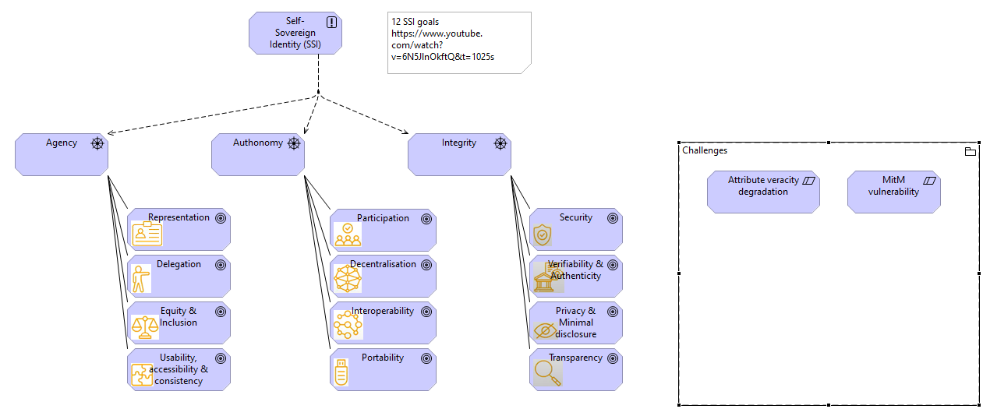
Self-Sovereign Identity

Slide 10

Models of corporate identity management
Federated
model
Multiple IdPs trust each other to act as one
3
Centralised
model
All apps trust
one IdP for
AuthN & AuthZ
2
Isolated
model
All apps fulfill
AuthN & AuthZ
autonomously
1

Slide 11

Cybersecurity
Services
IT Service &
Operations
Processes
ITSM
RPA
IT Service &
Operations
Processes
Program / Project
Change Mgt
Workforce
Business
Processes
B2B / Vendor
Business
Processes
Customer
Business
Processes
Security &
Compliance
Processes
Security
Processes
Notes:
This presentation fits among multiple decks covering reference enterprise architectures in different Cybersecurity domains which all, in turn, cover a vast range of activities. Governance, Risk & Compliance, GRC in short, which through cloudification increased the need for proper Vendor Risk Management, Cybersecurity Operations - commonly known as running a Security Operations Center or SoC, Proactive Services often associated with Red team activities and Business Continuity Planning, Vulnerability Management often linked to Attack Surface Monitoring and Endpoint detection, Awareness and training and the topic we will discuss today: Identity & Access Management.
As I said, this is an extremely high-level overview,

Slide 12
Identity & Access Mgt

Slide 13



Logical Access Mgt (LAM) orchestration
Privileged Access Mgt
(PAM)
Provisioning
Identity scoping
AuthN
AuthZ
Access
Principles & Policies
Identity
& Access Mgt
B2E
B2B
SAML
SSO
Coarse-grain
Emergency
SoD
PSM
Insider Threat Mgt
JML
JIT
M2M
B2C
OAuth
MFA
Fine-grain
Least privilege
Password Mgt
Vault
Citizen
B2B2C
OIDC
Digikey
ACL, ABAC, RBAC, RAdAC
Identity & Access Mgt
Notes:
I’m not going to explain in-depth why we need Enterprise Architecture, this deck is purposed to sharpen our insights on corporate access from a business perspective, and, I’d like to add a little twist by drawing your attention on issues we often see in absence of enterprise architectural authority.
that can arise from loose architectural control or loose interaction between business and IT on Identity & Access Management topics. Corporate Identity & Access Management, let alone any course corrections or adjustments in this domain represent serious and hard to justify investments.
Most IAM solutions are subscription models based on user population or authentication attempts
. Therefore scaling up causes a linear cost increase, with barely any advantage of scale.
and also explain what happens in case Identity & Access Management is not
CISOs and heads of security usually encounter in Cybersecurity-centric business contexts.
This deck is about corporate Identity & Access Management. By corporate, we mean all actors or personas that play a role in enabling business opportunities. In other words, all actors in the business ecosystem, except customers.
Of course, there are security frameworks that both help to identify gaps and propose good practices to alleviate specific concerns. Still, these frameworks are too technical to function as working documents at the management level. But as a global IT company with vast cross-industry experience and my long personal experience in IT project management and Enterprise Security Architecture, I’m sure Cybersecurity leadership rather likes to hear the pragmatic approach.
So, this exercise will not explain solutions in great detail but only put them in context by connecting the dots.
Connecting the dots, being the main purpose of Enterprise Architecture, results in a stable framework that keeps all the solutions in check with the security controls and security due diligence offered by technology, people and processes.
So, let’s go through a first architectural foundation covering a great cross-section of the Cybersecurity subjects a CISOs and heads of Cybersecurity are managing.
As we navigate the evolving landscape of cybersecurity, it's imperative for [Company Name] to fortify its defenses and ensure a resilient information security framework. Of course, I’m aware that you have already figured out an architecture that is fit for purpose, and I’m sure it has gone through multiple iterations already.
cybersecurity concerns we have captured fr
Thes reference architecture So’ what’s The Challenge here ?
First of all, Cybersecurity and Information security is a moving target. Therefore, realistically, IT does not manage to implement all the security needs to the full across the entire application and data landscape. I
I am not a professional security auditor, but from my experience as IT project manager for more than 20 years, I know, even in the largest banks on European soil, this situation is prevalent.
Corporations usually end up with a mix of products, IT architectures, temporary adaptations that become permanent and so on…
In today's interconnected world, the traditional perimeter is fading, making IAM a linchpin in our security strategy. Siloed and ad-hoc IAM solutions can lead to inefficiencies, compliance gaps, and heightened security risks. It's time to elevate our IAM game.
The Solution:
I propose the implementation of a comprehensive IAM Reference Architecture tailored for [Company Name]. This framework will provide a standardized blueprint, ensuring consistency, scalability, and resilience across our identity and access management practices.
Key Benefits:
Efficiency and Consistency: Streamline IAM processes, reduce redundancy, and establish a consistent approach to user access across the organization.
Scalability: As we grow, our IAM framework will seamlessly scale, accommodating new users, applications, and technologies without compromising security.
Risk Mitigation: Strengthen security postures by enforcing least privilege principles, enhancing authentication methods, and proactively addressing potential vulnerabilities.
Regulatory Compliance: Align our IAM practices with industry regulations and standards, ensuring that we not only meet but exceed compliance requirements.
Cost-effectiveness: By optimizing IAM processes and leveraging a standardized architecture, we can realize cost savings over time.
Next Steps:
I propose a meeting to discuss this initiative further. We can delve into the specifics, address any questions or concerns, and outline a roadmap for the seamless integration of our IAM Reference Architecture.
Our commitment to securing our digital assets is unwavering, and I believe that implementing a robust IAM Reference Architecture is a strategic move toward a more secure and agile future.
Thank you for your time, and I look forward to the opportunity to discuss this initiative in greater detail.
Best regards,
ACL, RBAC, ABAC (PBAC= ABAC with dynamic rules, CBAC= ABAC from MSFT), ACL, RAdAC
https://cloudentity.com/news/acl-rbac-abac-pbac-radac-and-a-dash-of-cbac/
ACL: Your name is on the list
RAdAC: You have been to a country with a COVID outbreak
ABAC: You’re the right age
RBAC: You have the role of system administrator

Slide 14
Corporate perimeters & personas
Scope: Federated Identity Management (FIM) perimeter
FIM
limit
Internal
Subsidiary
internal
Subsidiary
contractor
B2B Admin
B2B Partner
Customer
Franchise Customer
Digital
Citizen
Contractor
Robotic
System
HPA
B2B System
B2E
internal
B2E affiliates
B2B
delegates
B2B
non-affiliates
B2C
registered
B2B2C registered
B2C
unregistered
Notes:
Each Identity and Access Management system architecture must be tailored to
the organisational structure and the complexity of that structure - depending on the number of corporate personas
the security posture - to safeguard the nature of the business itself
the digital transformation - to remain ahead of competing business actors
are often dictated by a combination of regulatory requirements, organizational policies, industry standards, and the specific nature of the data and systems being protected.
Information security needs are often dictated by a combination of regulatory requirements, organizational policies, industry standards, and the specific nature of the data and systems being protected. Here are some key factors:
Regulations and Compliance: Many industries have specific regulations that dictate how certain types of information should be handled and secured. For example, healthcare has HIPAA, finance has PCI DSS, and there are various data protection laws globally.
Organizational Policies: Companies often establish their own internal policies and procedures to ensure the confidentiality, integrity, and availability of their information. These policies may be influenced by industry best practices.
Risk Management: Information security needs are also determined by an organization's risk management strategy. Understanding potential risks helps in implementing appropriate security measures to mitigate those risks.
Data Sensitivity: The sensitivity of the data being handled is a critical factor. Highly confidential or personally identifiable information requires more stringent security measures than less sensitive data.
Industry Standards: Following widely accepted security standards and frameworks, such as ISO 27001 or NIST, can provide a solid foundation for designing and implementing security measures.
Technology Landscape: The technologies in use also influence security needs. Cloud-based systems, mobile devices, and other technologies require specific security considerations.
Incident Response Requirements: The ability to respond to and recover from security incidents is a crucial aspect of information security planning. Security measures are often designed to facilitate effective incident response.
User Behavior and Education: Human factors play a significant role. Security needs are influenced by the awareness and behavior of end users. Training programs and awareness campaigns are essential components.
Considering these factors collectively helps organizations create a comprehensive and effective information security strategy. In your role in Enterprise Architecture, aligning security measures with the overall architecture and business objectives is crucial for a robust security posture.
Before we The first key approach to
HR limit: boundaries within which default corporate HR trust exists. B2B partners usually have an HR system but no trust by default.
IGA limit: boundaries within which users are entitled to perform user, role and permission management (including creation/deletion)
FIM limit: boundaries within which we can federate corporate identities into one identity per person
In the realm of Identity & Access Management (IAM), various personas play crucial roles in maintaining corporate identities and security. Here are a few key personas:
End Users: These are employees, contractors, or anyone else using the organization's systems and applications. Their access needs are typically defined by their job roles.
Administrators: IAM administrators manage user identities, access permissions, and overall security policies. They ensure that the right people have the right access.
Managers: Managers may have elevated privileges to oversee and manage the access rights of their team members. This is often essential for efficient workflow management.
Auditors: Auditors require access to IAM systems to assess and validate the security posture of the organization. They play a crucial role in ensuring compliance with regulatory standards.
Developers: In a corporate setting, developers may have specific access requirements to development environments, version control systems, and other tools critical to their work.
Vendors/Partners: External entities like vendors or partners may need temporary or limited access to specific resources within the corporate environment.
Automated Systems/Bots: Some IAM systems need to manage access for automated systems or bots that perform various tasks, such as data processing or system maintenance.
Each persona has unique access needs, and effective IAM ensures that access is granted based on job roles, responsibilities, and the principle of least privilege.

Slide 15
Backup slides

Slide 16
IAM
Vendor Risk Mgt
Training
Awareness
CISO
Vulnerability Mgt
Cyber Ops
Governance
Risk Mgt
Compliance
Architecture engineering
Proactive Svc

Slide 17
How do we start building architecture ? Answer: look at all the angles to approach the problems and solutions
List the use-cases we want to address
List the desired outcomes, expectations, and justify why we want them. (motivations)
List all the most likely required building blocks
List the risks and potential threats that require to be addressed in the design

Slide 18
Identity & Access Management (IAM) vs.
Federated Identity Management (FIM)

Slide 19
Logical Access Mgt (LAM)
Privileged Access Mgt
(PAM)
Provisioning
Identity scoping
AuthN
AuthZ
Access
Principles & Policies
Identity
& Access Mgt
B2E
B2B
SAML
SSO
Coarse-grain
Emergency
SoD
PSM
Insider Threat Mgt
JML
JIT
M2M
B2C
OAuth
MFA
Fine-grain
Least privilege
Password Mgt
Vault
Citizen
B2B2C
OIDC
Digikey
ACL, ABAC, RBAC, RAdAC
Awareness
& Training
Vendor Risk Management
Identity
& Access
Management
Notes:
ACL, RBAC, ABAC (PBAC= ABAC with dynamic rules, CBAC= ABAC from MSFT), ACL, RAdAC
https://cloudentity.com/news/acl-rbac-abac-pbac-radac-and-a-dash-of-cbac/
ACL: Your name is on the list
RAdAC: You have been to a country with a COVID outbreak
ABAC: You’re the right age
RBAC: You have the role of system administrator

